Slide 1
AI-Integrated Dental Health Record Management System
DBMS Mini-Project
Presented by: SHRI KRISHNA MISHRA(RA2311003010514)
KALRAV NARESH(RA2311003010533) Institution: SRM INSTITUTE OF SCIENCE AND TECHNOLOGY Date: 14/02/2025

Slide 2
Introduction
The AI-Integrated Dental Health Record Management System is designed to enhance dental care efficiency.
It integrates AI-powered bruxism & occlusion monitoring with a centralized health record system.
Provides role-based access control for patients, doctors, and administrators.

Slide 3


Problem Statement
Traditional dental record management is paper-based and inefficient.
Bruxism (teeth grinding) often goes undiagnosed, leading to severe dental issues.
Need for an AI-powered system to track, monitor, and alert for dental issues in real time.

Slide 4
Project Objectives
Develop a centralized patient database for managing dental health records.
Implement AI-powered bruxism & occlusion monitoring using sensor data.
Enable role-based access control for different users (doctors, patients, admin).
Automate appointment scheduling and treatment tracking.

Slide 5
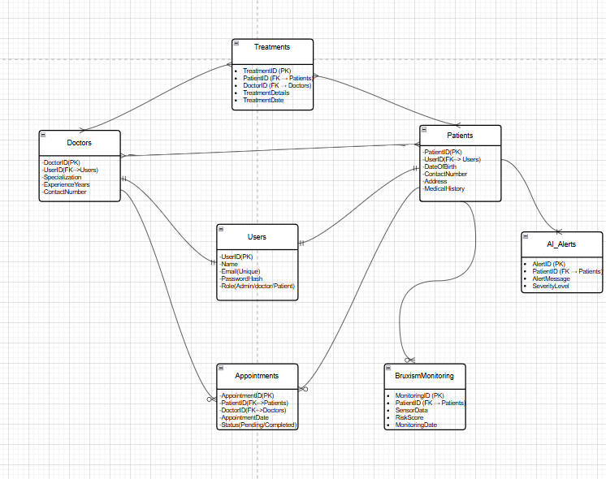

Entity-Relationship (ER) Diagram:
Users Table: Stores login details and roles.
Patients Table: Contains patient medical history.
Doctors Table: Maintains doctor information and specialization.
Appointments Table: Tracks patient-doctor appointments.
Bruxism Monitoring Table: Stores AI-detected bruxism risk scores.
AI Alerts Table: Generates alerts for severe bruxism cases.

Slide 6
Database Schema
Users Table: Stores login details and roles.
Patients Table: Contains patient medical history.
Doctors Table: Maintains doctor information and specialization.
Appointments Table: Tracks patient-doctor appointments.
Bruxism Monitoring Table: Stores AI-detected bruxism risk scores.
AI Alerts Table: Generates alerts for severe bruxism cases.

Slide 7
Key Features of the System
Role-Based Access Control – Secure access for doctors, patients, and admins.
AI-Powered Bruxism Detection – Identifies and alerts severe cases.
Automated Treatment Progress Tracking – Monitors patient improvement.
Sensor Data Storage – Records occlusion & bruxism-related sensor data.
User-Friendly Interface – Simplifies patient & doctor interactions.

Slide 8
System Workflow
Step 1: Patient registers & logs into the system.
Step 2: Doctor schedules an appointment.
Step 3: AI system monitors bruxism using sensor data.
Step 4: AI-generated alerts notify doctors of severe cases.
Step 5: Treatment history is updated in the database.

Slide 9
Technologies Used
Database: MySQL
ER Diagram Tool: draw.io
Back-End: Python (for AI processing)
Front-End: HTML, CSS (for user interface)
AI Integration: Machine Learning for Bruxism Analysis

Slide 10
Future Scope & Enhancements
Advanced AI Integration: More accurate AI-based dental diagnostics.
Mobile Application: For patient convenience.
Cloud Integration: Remote access to dental records.
Wearable Sensor Support: Continuous real-time monitoring.

Slide 11
Conclusion
The AI-Integrated Dental Health Record Management System improves efficiency in dental care.
AI-powered bruxism detection helps in early diagnosis and treatment.
Centralized database ensures smooth record management.
Future advancements can further enhance patient care.

